Slide 1
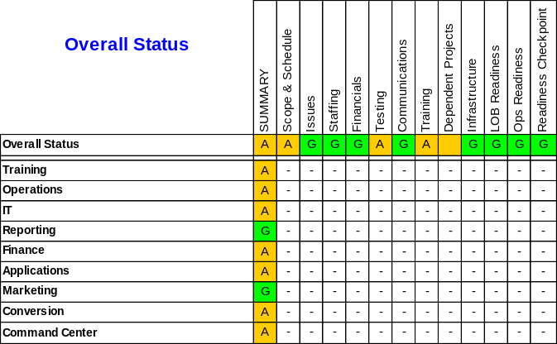
    (Name of Project) Key Project Update: As of Month ##, #### (Tuesday date)
    Project Sponsor(s):
    Project Manager:
  Project End Date: Month ##, #### Contact: Name and telephone #
Key Dates
Next 60 Days
Event Highlights: Status
99/99 Trebuchet MS 7 (No bullets, tell the story with all key dates)
Enter 4 digit date (##/##) then tab to enter text.
All milestones that are loaded to repository should appear here as well as all key project dates. Make sure all milestone dates entered here are also loaded to repository.
Since these are rolled up on Fridays, if you have a “key date” due on that Wed, Thurs, or Fri, talk about whether it will be met.
Trebuchet MS 8
Scope: (First bullet has to begin with Scope)
Tell the story. Be thorough. If you say the number of issues went from 150 to 28, you should state if 28 is critical or non critical.
Carry forward from previous report as necessary. Example: if an issue was logged in the previous report, then tell how it has been resolved, or current status. Follow up.
Double space when there is room to do so.
A
Open Issues
Red
Red: #
Amber: #
Green: #
        Project Team Updates
Trebuchet MS 8pt This should give updates on the sub project categories (heat map). Tell the story. Be thorough. Be complete and finish all thoughts. All RED and AMBER issues must be addressed here. May increase size of box to allow space for complete update. Double space between updates if possible. Every Risk and Issue has to have an action plan, an assigned to person (first initial and last name only), and a date.
Trebuchet MS 8pt Consider not only ourselves: consider market, audit, and executive perspective, ask yourself ‘What would the CEO, COO, CFO, Marketing, and Audit want to know?’.

Slide 2
    (Name of Project) Key Project Update: As of Month ##, #### (Tuesday date)
    Project Sponsor(s):
    Project Manager:
  Project End Date: Month ##, ####
Top Risks & Mitigation Activities
Trebuchet MS 8 pt
Tell the story. This may be a repeat of some of the updates on the first page.
Be thorough.
Be complete and finish all thoughts.
May increase size of box to allow space for complete update.
Every Risk and Issue has to have an action plan, assigned to person (first initial and last name only) and a date. Please make the word Risk and Mitigant bold prior to your sentence.
Make use of space provided. Double space if possible.
Team Action Items
Trebuchet MS 8pt
This would generally include action items at a lower level than milestones. Please include details. List person (first initial and last name) and end date which is assigned to this action item.
Could be repeat of some “key dates” on front page with additional details.
Gaps/Differences
        Workstream Updates
LOB Readiness
Overall Readiness
Trebuchet MS 8 pt
LOB Updates
Trebuchet MS 8 pt
If all boxes are not needed for LOB status and comments, these boxes can be used for other key workstreams, i.e. training, implementation, command center forms, etc.
LOB Updates
Trebuchet MS 8 pt
G
G
G
LOB Updates
Trebuchet MS 8 pt
LOB Updates
Trebuchet MS 8 pt
G
G

Slide 3
Some general instructions to follow along with the instructions included within the template:
DO NOT SUBMIT THIS PAGE
Some general instructions to follow along with the instructions included within the template:
Headings showing the name of the project has to be updated on each page. It does not pull over as a heading. Headings should be in blue text.
Reports will be completed on Tuesday, so the date of the report will be dated as of Tuesday.
Bullets should be square and blue.
Text should be black.
When using color identifiers, use all caps (RED, AMBER, GREEN).
If you are carrying a past due milestone, and you want to continue to carry as past due (i.e. you are not modifying the date), please asterisk (*) the milestone and indicate in the STATUS SECTION when you think the milestone might be met.
Make sure under open issues on the first page you actually have a number not the # sign. If it is Zero please place a 0 in the box.
Heat Map Instructions:
  Should have a line for all sub teams RAG (red, amber, green) status.
  If you have a specific subproject that has been completed you will put a C in the box and turn it white.
  Command Center (a/k/a readiness review) must be included for every project.
  If a component does not apply to a particular sub project, leave color white and enter (-) in that square. Once project reporting is started and the subprojects listed on left side of the heat map are populated, additional subprojects cannot be added.
  In order to make changes to the Overall Status box: First click once on the heat map>Draw in lower left corner of window>Order>Send to back. This will
  allow the Overall Status box to come to the front and will allow you to make changes.
  Pease put the color status in the Overall Readiness boxes.
  If you have an AMBER or RED rating in your heat map you will need to include a description, and what you are doing to mitigate it (them), including dates and people in the PROJECT TEAM UPDATES section on the first page. Make sure you complete your RAG # as issues as well. One Amber or Red rating in your heat map may correspond to numerous issues, or the other way around. One issue may cause numerous Amber or Red ratings in your heat map, they do not necessary match off one for one.
  Review each line item under each sub-team and indicate B and the color blue if "not started", indicate a dash (-) if the category is NA. Carry this throughout your readiness boxes on the second page as needed.
In the Top Risk & Mitigation Activities section, while the format is still bullets, the risk should be stated first, then the word "Mitigant": should precede the mitigating
statement. Please make sure the words Risk and Mitigant are bold.

